Slide 1

Financial Planner
Team Member:-
Pujitha Gaddam [IU1682820024]
Rishee Barthakur [IU1682820025]
Internal Guide:-
Prof. Kirtan Kumar Rathod
FINANCIAL PLANNER
1

Slide 2


Slide 3
INDEX
Project Profile
Introduction
Need for the System
Scope of the system
Modules & Users
Tools & Technology
Analysis
System Flow Diagram
UML Diagrams
Design
Data Entry Screens (Samples)
Reports (Samples)
Test Plan & Test Cases
Future Work
Bibliography
FINANCIAL PLANNER
3

Slide 4
INTRODUCTION
Managing the present and future goals.
Financial planning is the process of planning, accessing, setting, reviewing your financial goals for future as well as present terms.
Its not only about the investment criteria or the building wealth portion but also to maintain and setting up everyday spending limit, planning for retirement, setting up home loans, planning for a family, planning for children’s education, setting up life insurance, accessing the amount of wealth that resides with oneself, making plans to achieve a certain amount of financial goal and much more. All of these facets are interconnected for a financial plan.
Financial plans help you make more realistic plans, evaluate better alternatives and to give a thought in various perspectives and taking effective and essential decisions accordingly.

Slide 5
NEED FOR THE SYSTEM?
This app helps to access the finances and make a plan accordingly in order to assist in any situation.
Everyone has a long-term or short term goal. So there must be adequate amount of money in order to accomplish those financial futuristic goals, hence, this app help to set a proper financial goal for plotting through various courses.
This app helps to plan your finances in accordance that it funds you in any situation whether in bad or worse unexpected situation.
It helps to Track and monitor as well as manage the portfolio depicting the amount incomings and outgoings of the money invested and the amount actually withhold and the similarly the returns on it.
It displays accurate results by neglecting the tedious mathematical calculations manually with a quick response in no time.
FINANCIAL PLANNER
5

Slide 6
SCOPE OF THE SYSTEM
The user must be able to calculate the EMI(Equity Monthly Interest).
The user must be able to compare various loans.
The user must be able to analyze/ manage his/her wealth.
The user must be able to set the financial goal and plan the investment accordingly.
The financial goals must include:
retirement plan .
children’s marriage.
plan a house.
financial target.
The user must be able to calculate the SIP(Systematic investment Planning).
The user must be able to calculate the amount of Fixed deposit.
The user must be able to calculate the amount of Recurring deposit.
The user must be able to view the finance website for better investment ideas.
The user must be able to view the live financial market.
There must be proper visualized graphs regarding the total amount invested or received.
FINANCIAL PLANNER
6

Slide 7
SYSTEM MODULES
Modules:
Log In
EMI Calculator
Loan Compare
Wealth Analysis
Goals:
Retirement Plan
Children’s Marriage
House Plan
Financial Target
Systematic Investment Plan
Fixed Deposit
Recurring Deposit
Investment Ideas
Live Financial market
Users
Client
FINANCIAL PLANNER
7

Slide 8
TOOLS AND TECHNOLOGIES
Tools | Android Studio
Language | Java, XML
Database | Firebase Database
Operating System | Android
Application Size | 25MB
FINANCIAL PLANNER
8

Slide 9
EXISTING VS PROPOSED SYSTEM
Existing system does not have a facility of live market or direct connectivity to the web browser for investment ideas whereas proposed system has this facility for getting various investment ideas.
Existing system does not have any facility of wealth analysis module, which provides with the information which gives out the result of much wealth you withhold in total in FD,RD and EMI respectively and how much amount of money you can actually save and need in future.

Slide 10
SYSTEM FLOW CHART
FINANCIAL PLANNER
10

Slide 11
FINANCIAL PLANNER
11

Slide 12
USE CASE DIAGRAM
FINANCIAL PLANNER
12

Slide 14
ACTIVITY DIAGRAM
FINANCIAL PLANNER
14

Slide 16
CLASS DIAGRAM
FINANCIAL PLANNER
16

Slide 18
DESIGN
User Interface
FINANCIAL PLANNER
18

Slide 19
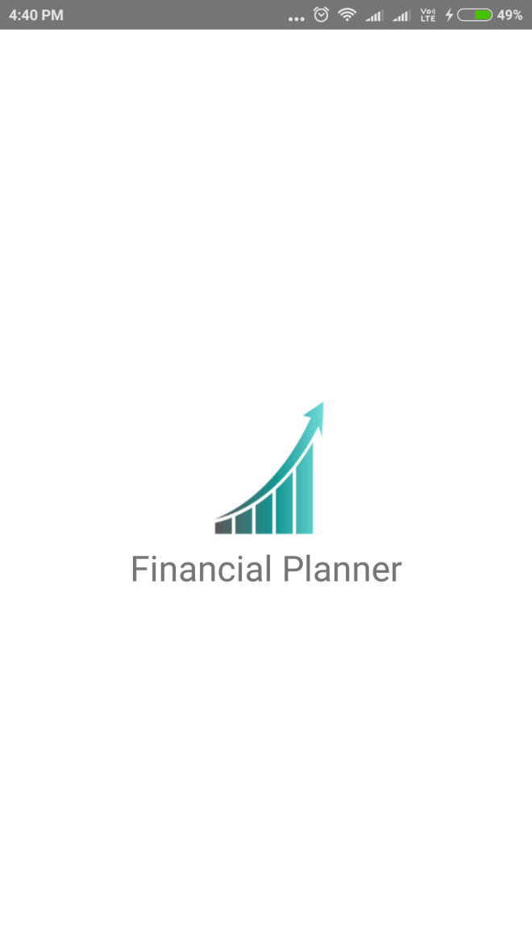
Splash screen

Slide 20
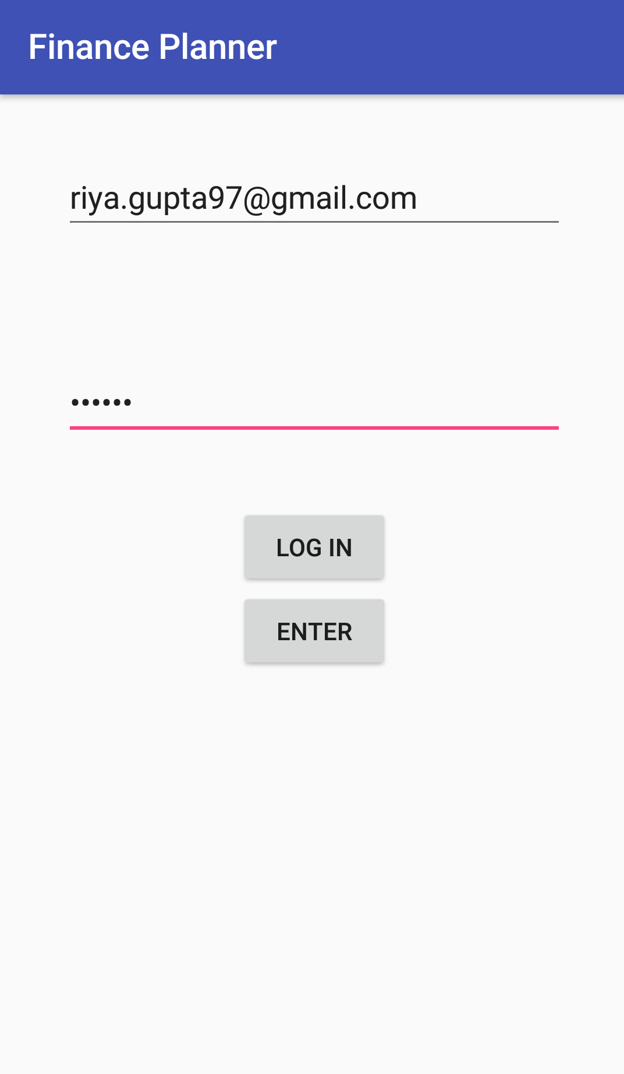
Login screen:

Slide 21
Login specifications:
Data/UI elements | Data considerations | Behavior considerations
Username | Text entry field | Mandatory field. Displays the username as entered as per the specifications.
Password | Text entry field | Mandatory field. Displays the password (in encrypted format) as entered as per the specifications.
Login | Button | On users click, when the password matches the one in the database, this screen redirects it to the dashboard screen.
Enter | Button | (for temporary purpose) it will directly redirect to the dashboard screen.

Slide 22
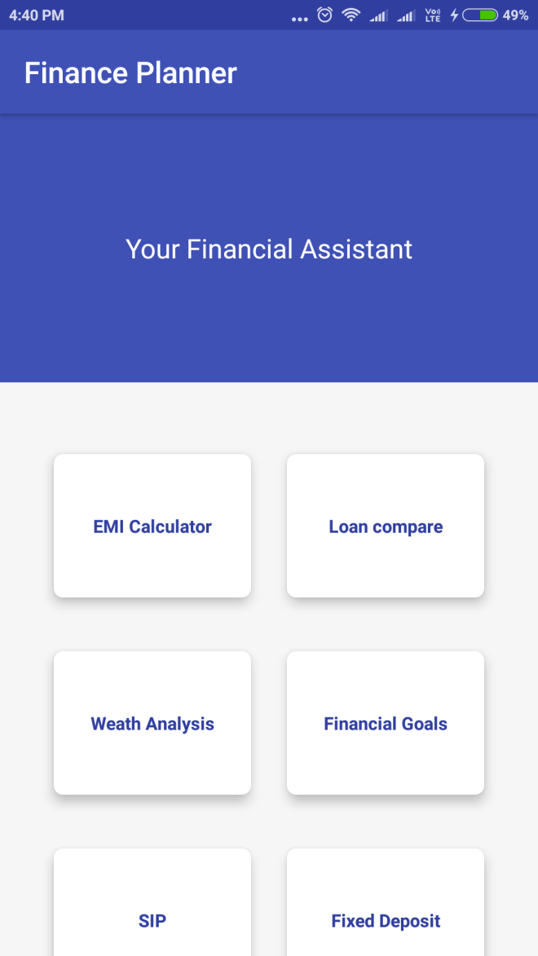
Dashboard screen-1

Slide 23
Dashboard Specifications:
Data/UI elements | Data considerations | Behavior considerations
Emi calculator | Cardview | On users click displays the EMI calculator screen
Loan compare | Cardview | On users click, a loan compare page open that compares 2 loans.
Wealth analysis | Cardview | On users click, it displays the analysis of wealth stored in various modules such as RD,FD.
Financial goals | Cardview | On users click, it displays a page again with 4 more modules i.e. The retirement plan, children’s marriage, plan a house and financial target.
FINANCIAL PLANNER
23

Slide 24
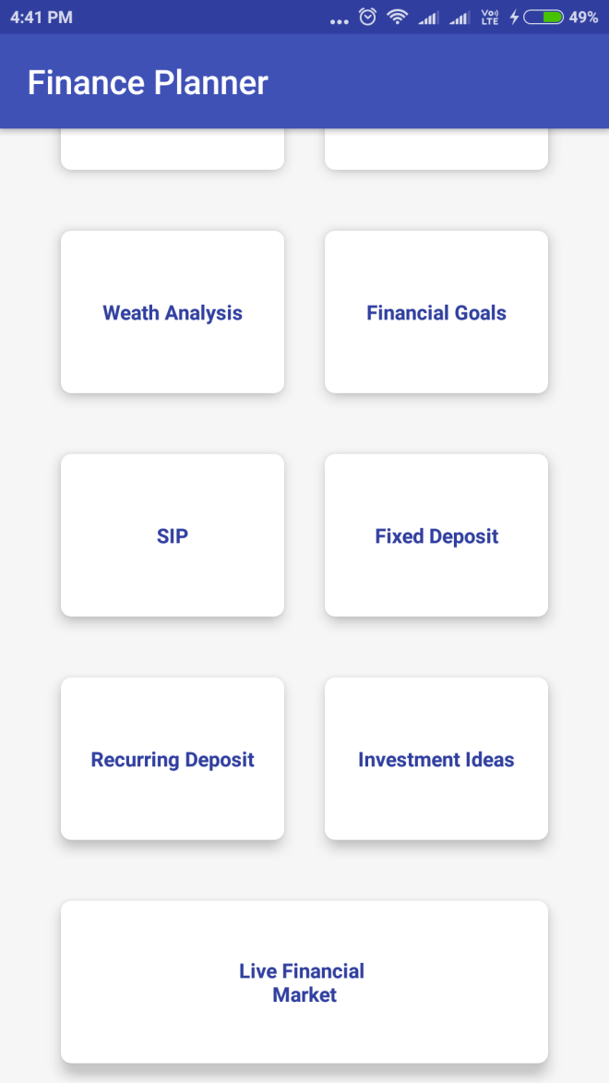
Dashboard screen-2

Slide 25
Data/UI elements | Data considerations | Behavior considerations
SIP | Cardview | On users click, it displays a Systematic investment planning page.
Fixed deposit | Cardview | On users click, it displays a Fixed deposit page.
Recurring deposit | Cardview | On users click, it displays a Recurring deposit page.
Investment ideas | CardView | On users click, it re-directs to a page opening a browser inside the app itself and also re-directs www.businesstoday.com
SIP | Cardview | On users click, it displays a Systematic investment planning page.

Slide 26
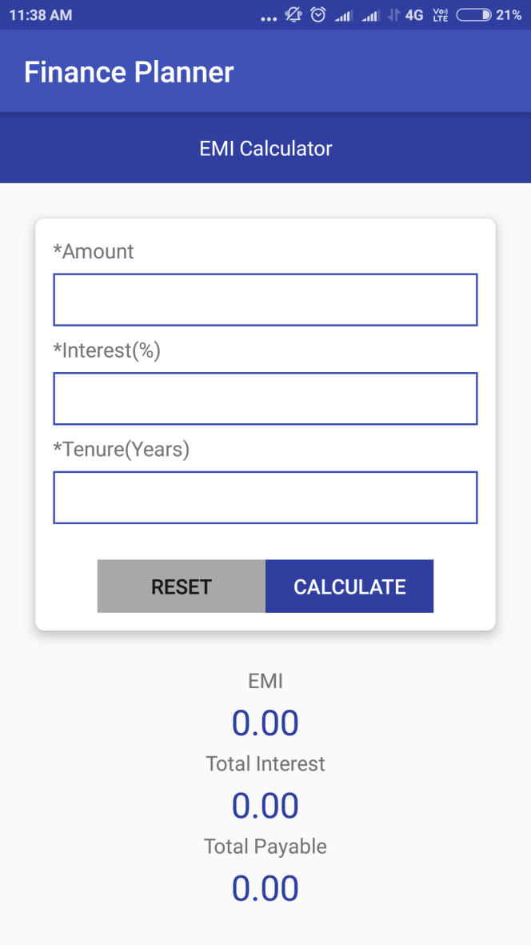
EMI Calculator
FINANCIAL PLANNER
26

Slide 27
EMI Calculator Specifications:
Data/UI element | Data considerations | Behavior considerations
Amount | Text entry field | Mandatory field. Displays the amount as entered.
Interest(%) | Text entry field | Mandatory field Displays the interest as entered
Tenure(years) | Text entry field | Mandatory field Displays the tenure in years format as entered.
Reset | Button | On users click, it refreshes the all the details previously filled.
FINANCIAL PLANNER
27

Slide 28
Data/UI element | Data considerations | Behavior considerations
Calculate | Button | On users click, it calculates the EMI and gives the result.
EMI | Textview | It displays the EMI result
Total interest | Textview | It displays the interest amount that is levied on the loan amount.
Total payable | Textview | It displays the amount deposited (principal amount + interest) on it.

Slide 29
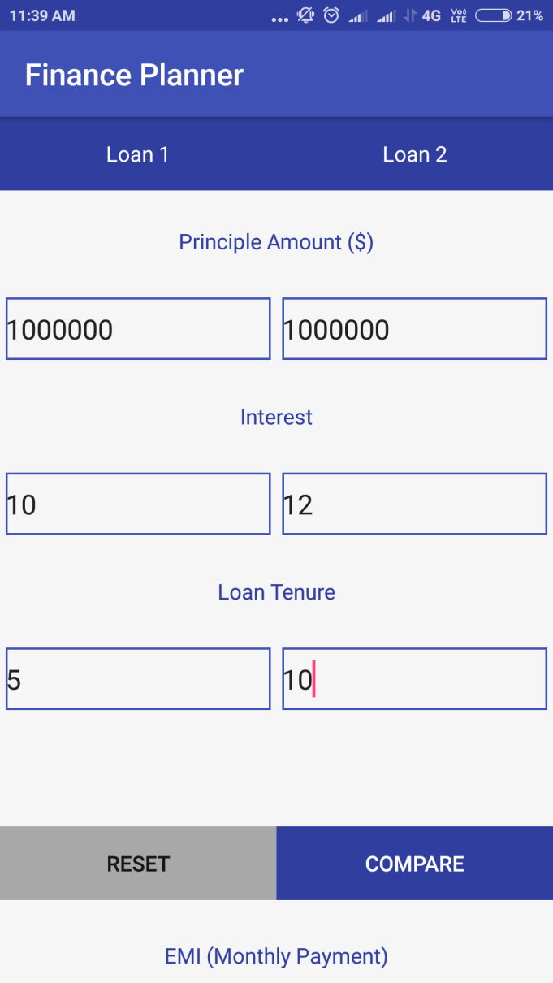
Loan Compare-1
FINANCIAL PLANNER
29

Slide 30
Loan Compare Specifications:
Data/UI element | Data considerations | Behavior considerations
Principal Amount | Text entry field | Mandatory field. Displays the amount as entered.
Interest(%) | Text entry field | Mandatory field. Displays the interest(monthly) as entered.
Loan Tenure(year) | Text entry field | Mandatory field Displays the tenure(year) as entered.
Reset | Button | On users click, it refreshes the all the details previously filled for 2 loans simultaneously.
FINANCIAL PLANNER
30

Slide 31
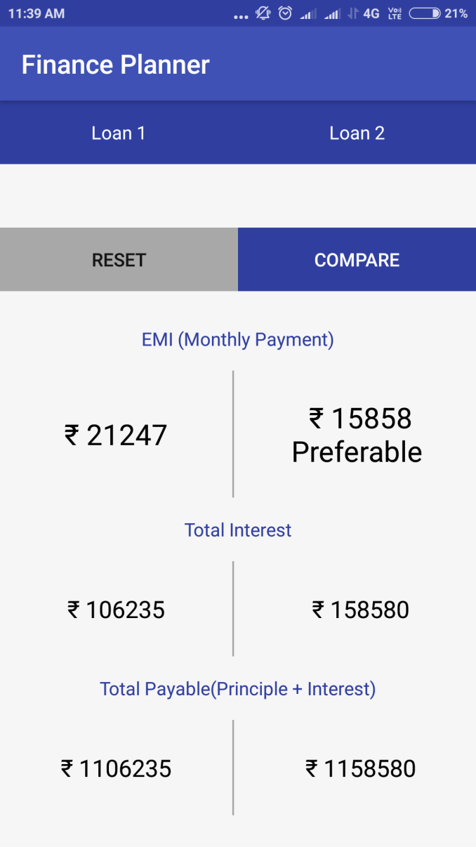
Loan Compare-2

Slide 32
Data/UI element | Data considerations | Behavior considerations
compare | Button | On users click it calculates the EMI and gives the result for 2 loans simultaneously.
EMI(monthly payment) | Textview | It displays the EMI result
Total interest | Textview | It displays the interest amount that is levied on the loan amount.
Total payable(principle + interest) | Textview | It displays the amount deposited ( principal amount + Interest )on it.

Slide 33
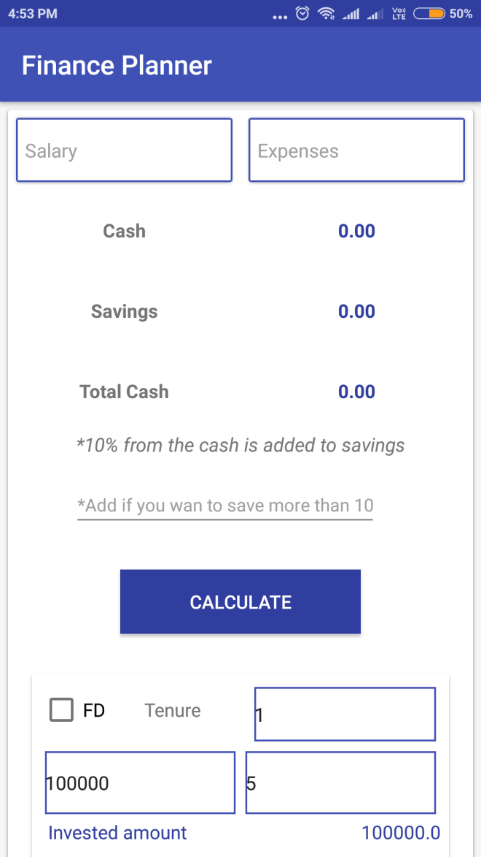
Wealth Analysis-1
FINANCIAL PLANNER
33

Slide 34
Wealth Analysis Specifications:
Data/ui elements | Data considerations | Behavior considerations
Salary | Text entry field | Mandatory field. It displays the salary of the user as entered.
Expenses | Text entry field | Mandatory field. It displays the expenses incurred by the user as entered.
Cash | Textview | It displays the amount of cash left (i.e. the salary minus the expenses)
Savings | Textview | It is the 10% amount from the cash left with the user.
Total cash | Textview | It displays the total cash withhold (i.e. 10% from the cash is added to savings).
Calculate | Button | On users click, it displays the above details.

Slide 35
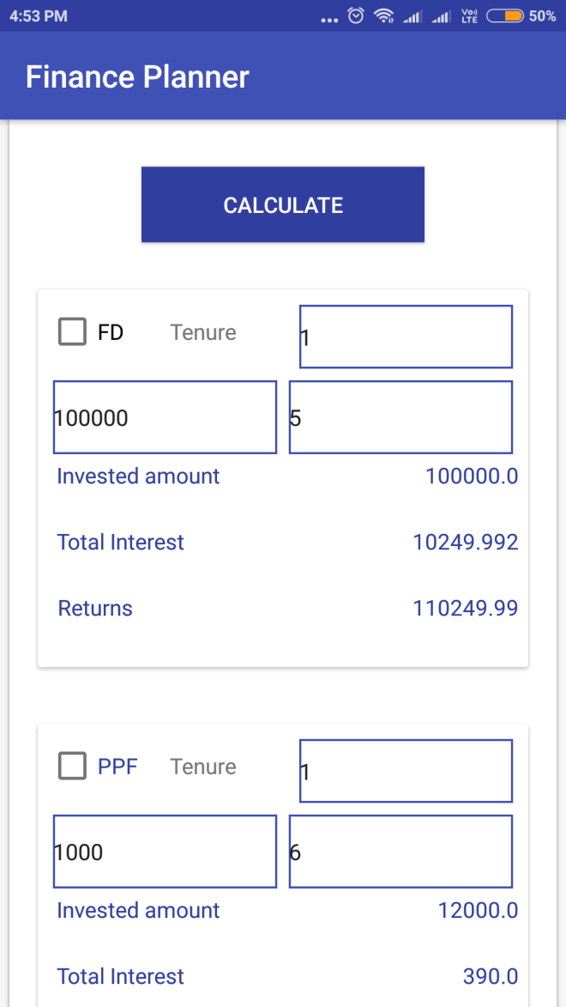
Wealth Analysis-2

Slide 36
Data/ui elements | Data considerations | Behavior considerations
Fixed deposit(FD) | Check box | When the user clicks on the checkbox, it displays the tenure, the amount invested and rate of interest as entered.
Invested amount | Textview | It displays the total amount invested for a particular duration.
Total interest | Textview | It displays the interest amount (levied on the amount deposited)
Returns | Textview | It displays the total amount that is received (i.e. principal amount+ interest)

Slide 37
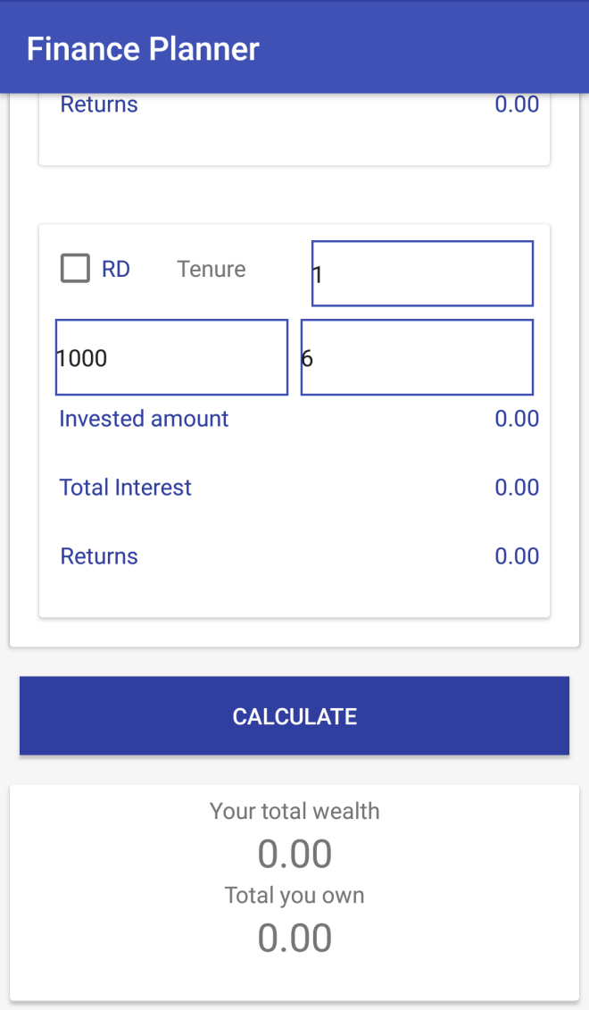
Wealth Analysis-3

Slide 38
Data/ui elements | Data considerations | Behavior considerations
Recurring deposit(RD) | Checkbox | When the user clicks on the checkbox, it displays the tenure, the amount invested and rate of interest as entered.
Invested amount | Textview | It displays the total amount invested for a particular duration.
Total interest | Textview | It displays the interest amount (levied on the amount deposited)
Returns | Textview | It displays the total amount that is received (i.e. principal amount+ interest).
Calculate | Button | On users click, it displays the your total current wealth in hand (invested amount in total)and the total amount you own(the total returns).

Slide 39
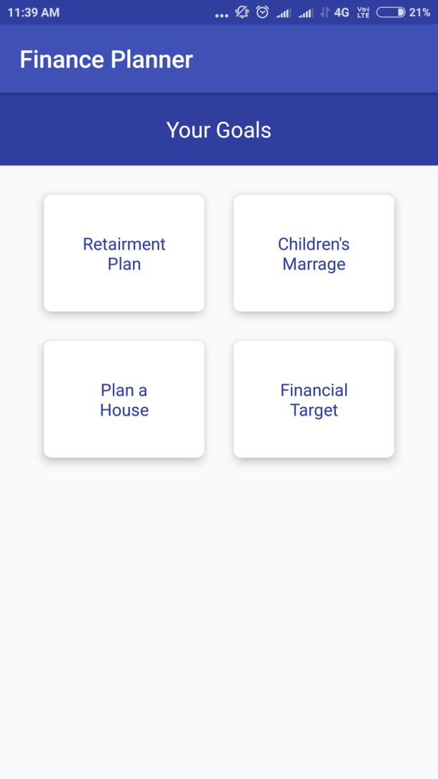
Financial Goals
FINANCIAL PLANNER
39

Slide 40
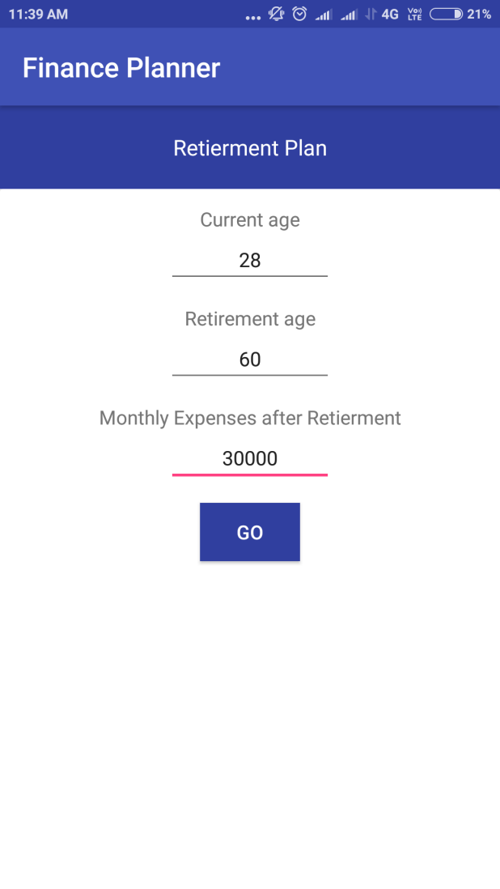
Retirement Plan-1
FINANCIAL PLANNER
40

Slide 41
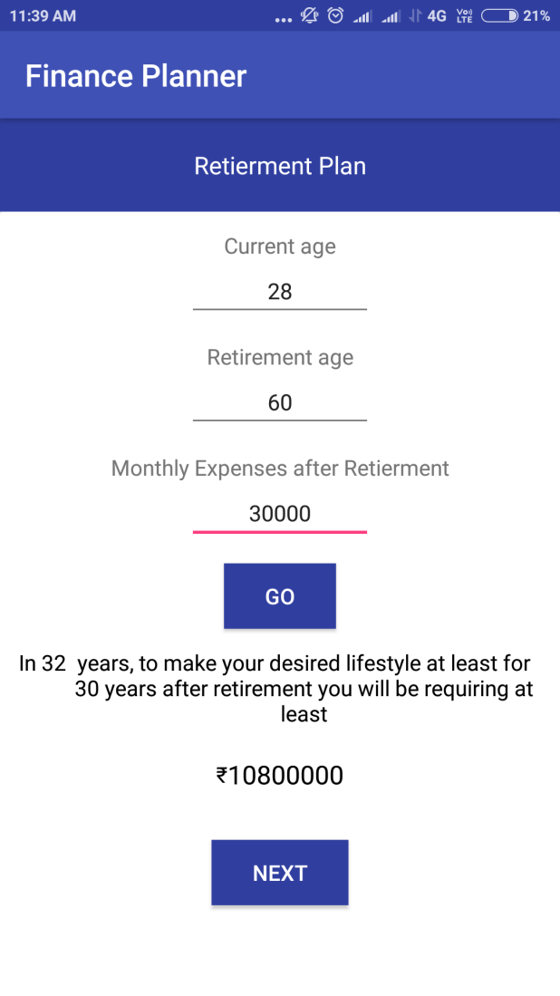
Retirement Plan-2

Slide 42
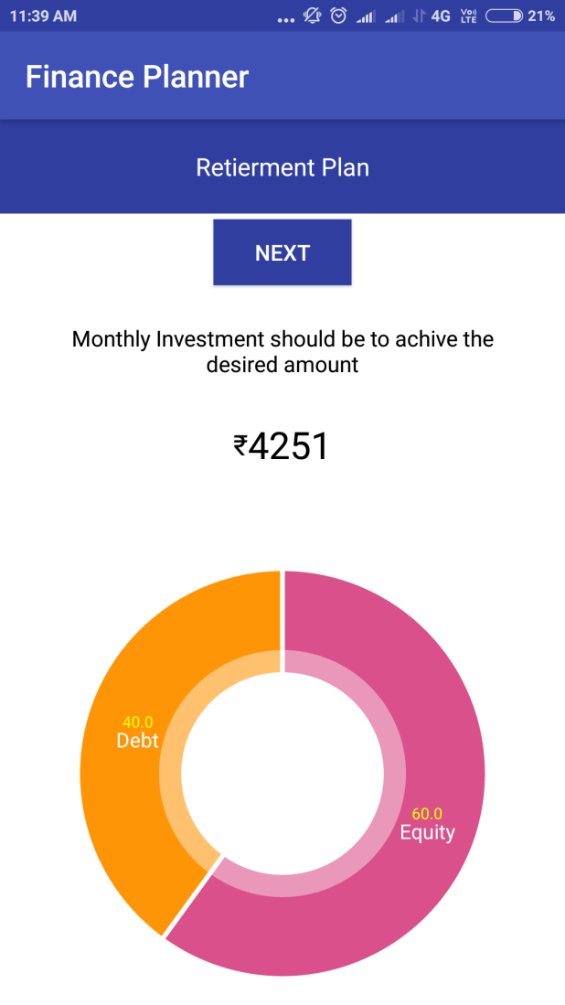
Retirement Plan-3

Slide 43
Retirement Plan Specifications:
Data/UI element | Data considerations | Behavior considerations
Current age | edittext | Mandatory field. it displays the current age of the user as entered.
Retirement age | edittext | Mandatory field. it displays the retirement age of the user as entered.
Monthly expenses after retirement | exietext | Mandatory field. it displays the monthly expenses that are actually needed or rather desired to have after retirement as Entered.
Go | button | On users click, it proceeds further to calculate how much money is actually required in ordered to get that much amount of desired monthly expenses after retirement.
Next | button | On users click, it displays the result based on the monthly investment that is required to achieve that much amount. and also displays a pie chart, showing two legnedaries:1.equity 2.debt.
FINANCIAL PLANNER
43

Slide 44
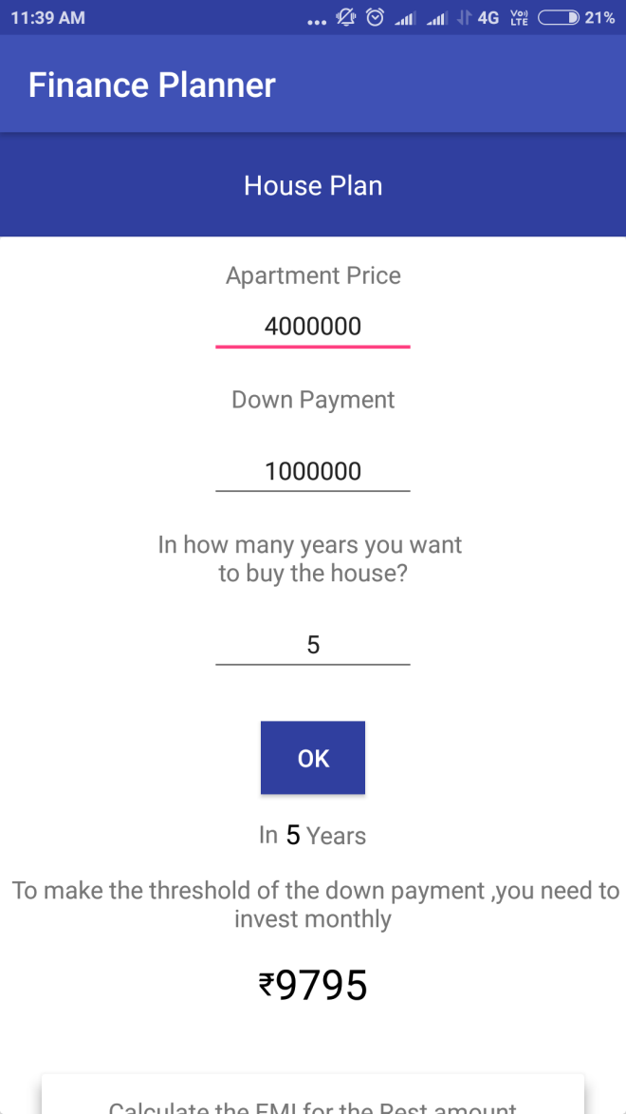
House Plan-1
FINANCIAL PLANNER
44

Slide 45
House Plan Specifications:
Data/UI elements | Data considerations | Behavior considerations
Apartment price | Text entry field | Mandatory field. It displays the price of the apartment as entered.
Down payment | Text entry field | Mandatory field.it displays the amount that is to be paid in advance.
In how many years you want to buy the house? | Text entry field | Mandatory field. it displays the tenure as entered.
Ok | Button | On users click, it displays that in how many years(as per the tenure entered) ,how much monthly investment is required to make the threshold of the down payment.
FINANCIAL PLANNER
45

Slide 46
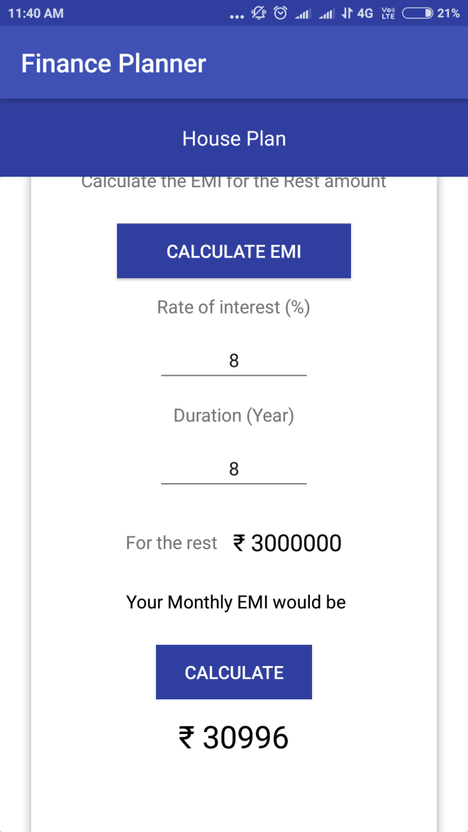
House Plan-2

Slide 47
Data/UI elements | Data considerations | Behavior considerations
Calculate EMI | Button | On users click, it displays the monthly deposit that is need to make in order to pay back the apartment price (apart from the down payment)
Rate of interest(%) | Text entry field | Mandatory field. it displays the rate of interest i.e. levied on the amount.
Duration(year) | Text entry field | It displays the tenure as entered.
For the rest | Text entry field | It displays the amount EMI required to pay the rest amount.
Calculate | Button | On users click, it displays the EMI result based on the above details filled

Slide 48
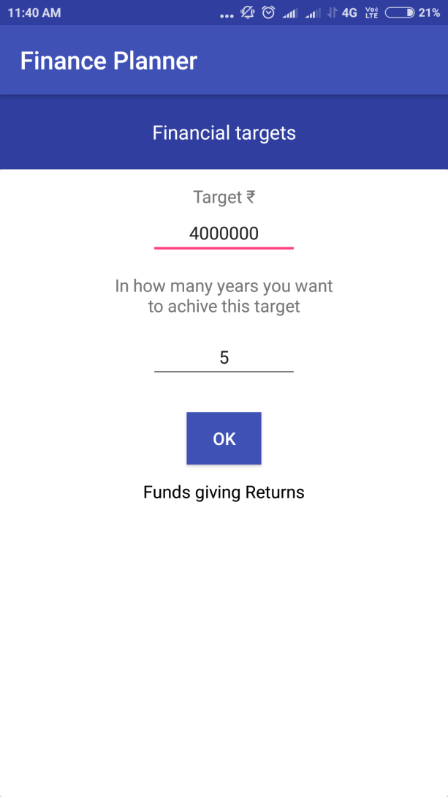
Financial Target-1
FINANCIAL PLANNER
48

Slide 49
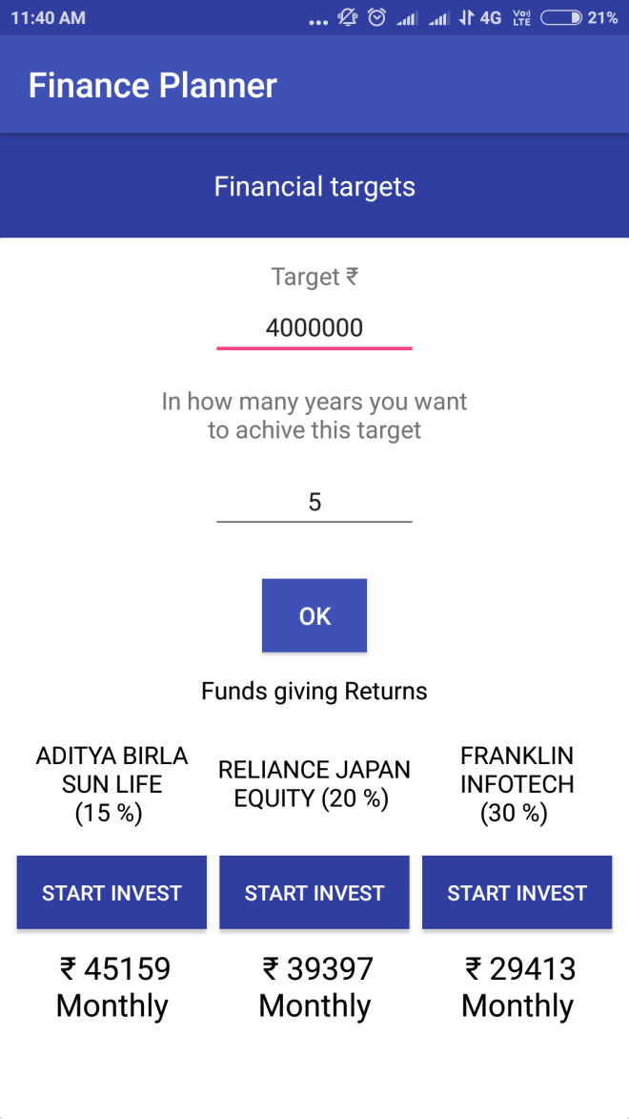
Financial Target-2

Slide 50
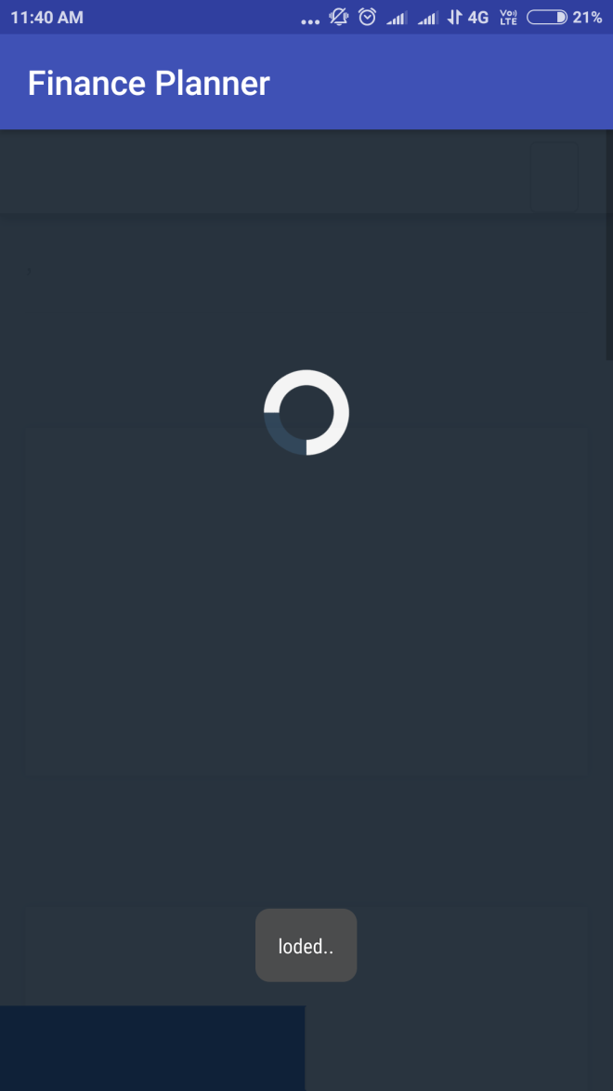
Financial Target-3

Slide 51
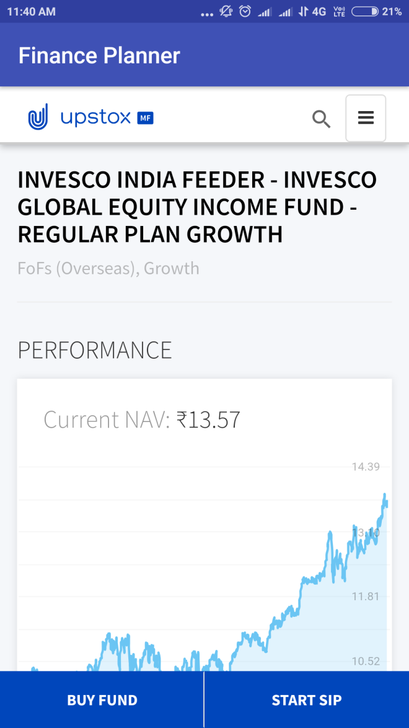
Financial Target-4

Slide 52
Financial Target Specifications:
Data/ui elements | Data considerations | Behavior considerations
Target | Text entry field | Mandatory field.it displays the amount that is needed in future.
In how many years would you want to achieve the target? | Text entry field | Mandatory field.it displays the tenure period that is required to get that much amount of money as specified.
Ok | Button | On users click, various schemes are displayed indicating various rate of interests provided by them.
Start invest | Button | On users click, it displays how much amount id needed to invest monthly and it redirects to the website browser.
Buy fund | Button | on users click it helps to buy the fund.
Start SIP | Button | On users click it redirects the page to buy the SIP.

Slide 53
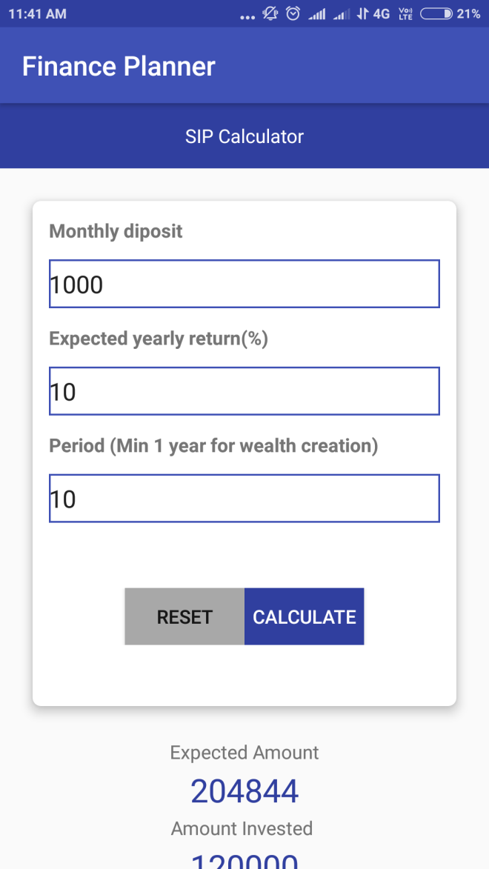
Systematic Investment Plan-1
FINANCIAL PLANNER
53

Slide 54
Systematic Investment Plan
Specifications:
Data/UI element | Data considerations | Behavior considerations
Monthly deposit | Text entry field | Mandatory field. Displays the amount that is deposited monthly as entered.
Expected yearly return (%) | Text entry field | Mandatory field. Displays the rate of interest as entered.
Period (Min 1 year for wealth creation) | Text entry field | Mandatory field. Displays the tenure and must be at least 1 year duration as entered.
Reset | Button | On users click, it refreshes the all the details previously filled.
FINANCIAL PLANNER
54

Slide 55
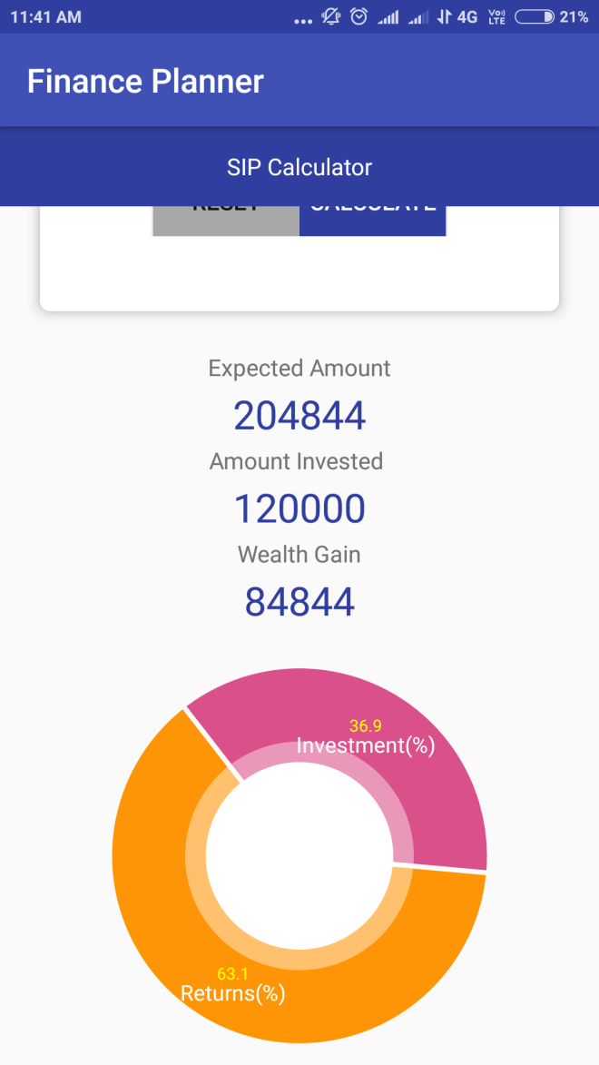
Systematic Investment Plan-2

Slide 56
Data/UI element | Data considerations | Behavior considerations
Calculate | Button | On users click ,it calculates the Systematic investment amount and gives the result.
Expected amount | Textview | It displays the amount that will be received after a particular duration.
Amount invested | Textview | It displays the total amount actually invested.
Wealth gain | Textview | It displays the amount of profit gained after interest accrued in the amount deposited.
Calculate | Button | On users click , it calculates the Systematic investment amount and gives the result.

Slide 57
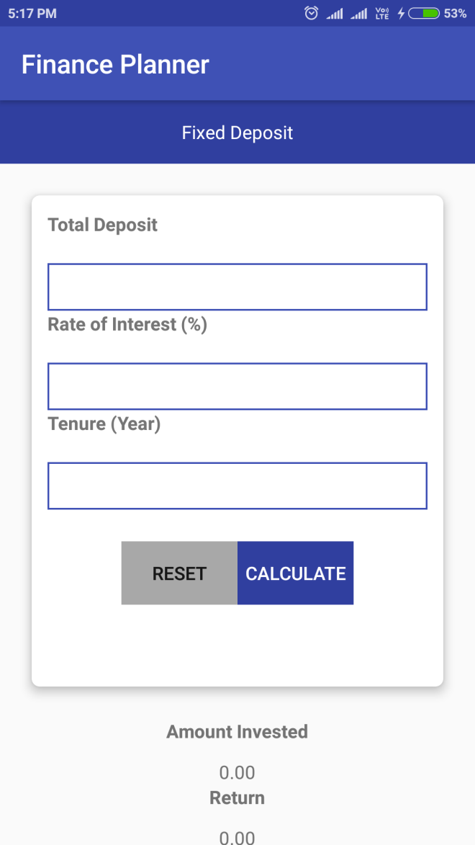
Fixed Deposit-1
FINANCIAL PLANNER
57

Slide 58
Fixed deposit specifications:
Data/UI element | Data considerations | Behavior considerations
Total deposit. | Text entry field | Mandatory field. Displays the amount that is deposited monthly as entered.
Rate of interest (%) | Text entry field | Mandatory field. Displays the rate of interest as entered.
Tenure(year) | Text entry field | Mandatory field. Displays the tenure in years format as entered.
Reset | Button | On users click, it refreshes all the details previously filled.
FINANCIAL PLANNER
58

Slide 59
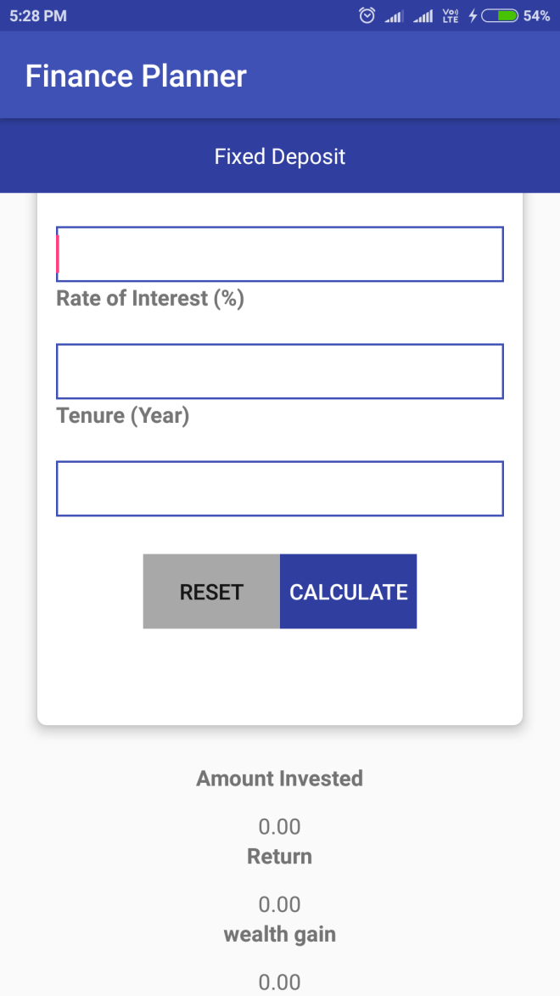
Fixed Deposit-2

Slide 60
Data/UI element | Data considerations | Behavior considerations
Calculate | Button | On users click it calculates the Fixed deposit and gives the result.
Amount invested | Textview | It displays the total amount actually invested for the total duration.
Return | Textview | It displays the total interest amount on that total deposit.
Wealth gain | Textview | It displays the amount of profit gained after interest accrued on the amount deposited.

Slide 61
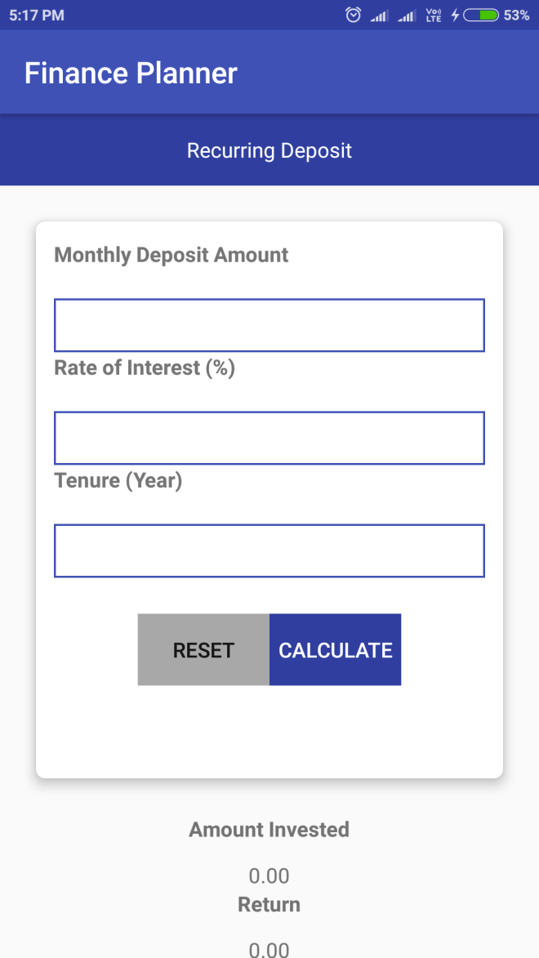
Recurring Deposit-1
FINANCIAL PLANNER
61

Slide 62
Recurring Deposit Specifications:
Data/UI element | Data considerations | Behavior considerations
Monthly deposit amount | Text entry field | Mandatory field. Displays the amount that is deposited monthly as entered.
Rate of interest(%) | Text entry field | Mandatory field. Displays the rate of interest as entered.
Tenure(year) | Text entry field | Mandatory field. Displays the tenure in years format as entered.
Reset | Button | On users click, it refreshes the all the details previously filled.
FINANCIAL PLANNER
62

Slide 63

Recurring Deposit-2

Slide 64
Data/UI element | Data considerations | Behavior considerations
Calculate | Button | On users click, it calculates the Recurring deposit and gives the result.
Amount invested | Textview | It displays the total amount actually invested.
Return | Textview | It displays the interest amount on the amount invested.
Wealth gain | Textview | It displays the amount of profit gained after interest accrued on the amount deposited.

Slide 65

Investment Ideas-1
FINANCIAL PLANNER
65

Slide 66
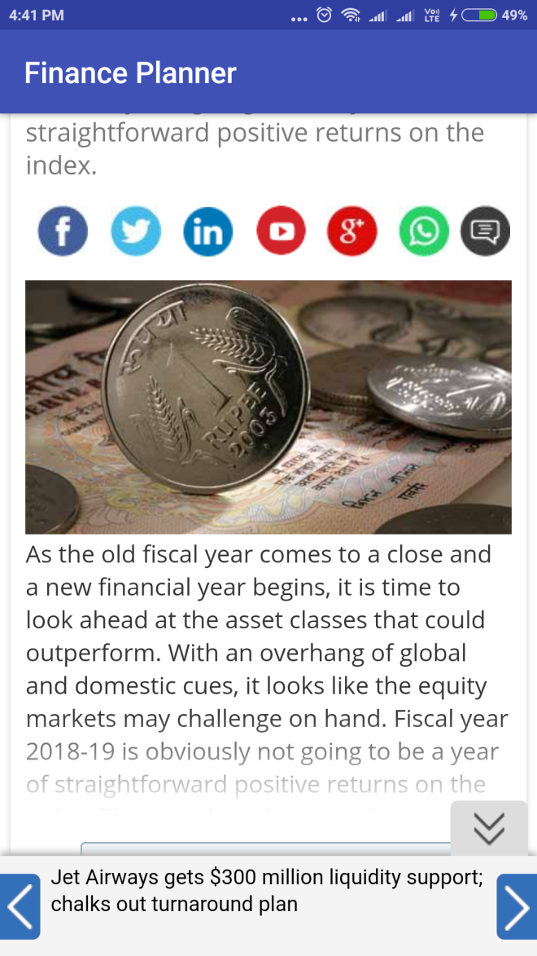
Investment Ideas-2

Slide 67
Investment Ideas Specifications:
Data/UI element | Data considerations | Behavior considerations
Investment ideas module | CardView | On users click, re-directs to the www.businesstoday.com page.

Slide 68
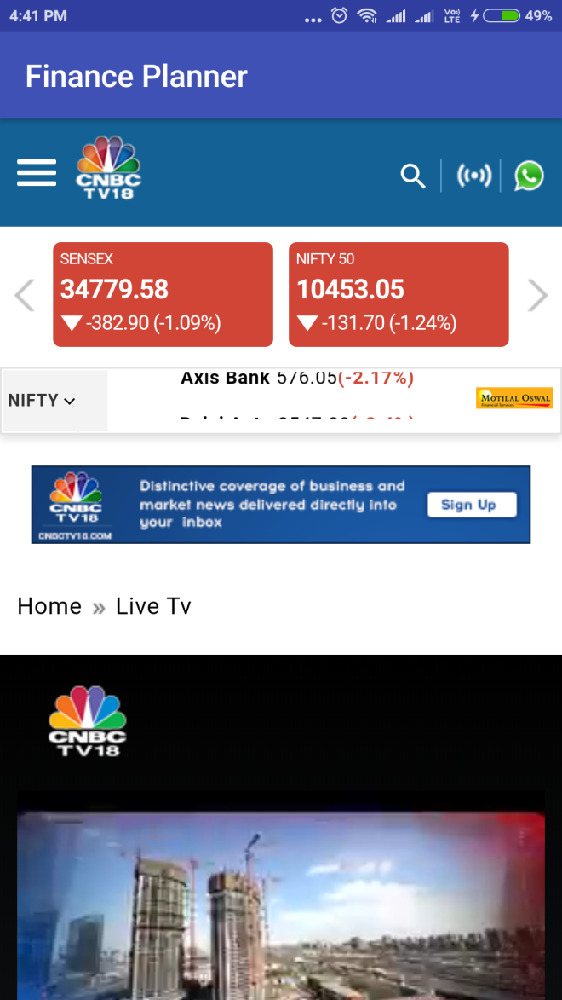
Live Financial Market-1
FINANCIAL PLANNER
68

Slide 69
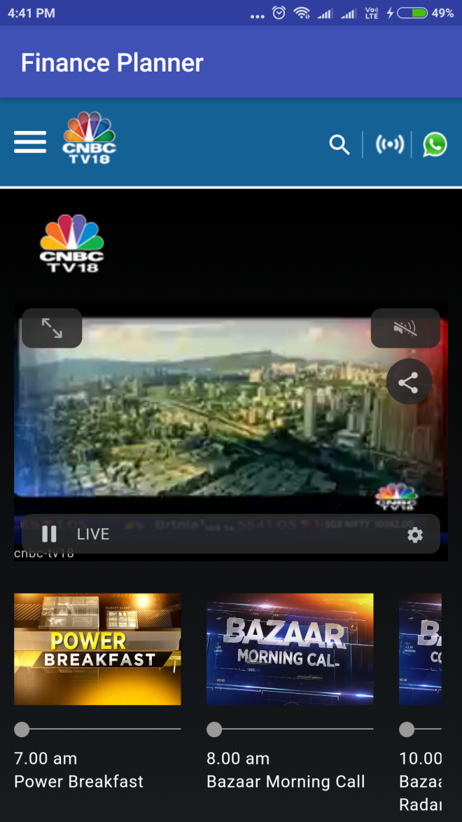
Live Financial Market-2

Slide 70
Live Financial Market Specifications:
Data/UI element | Data considerations | Behavior considerations
Live financial market module | CardView | On users click, re-directs to the CNBC live market page.

Slide 71
TEST PLANS
AND
TEST CASES:

Slide 72
For Login:
TEST CASE# | DESRIPTION | PRECAUTIONS | STEP# | TEST SCENARIOS | EXPECTED RESULT | ACTUAL RESULT
TC0-000 | App installation to launch screen |  | 1 | Install the app and launch the app on the device for the first time. | A splash screen must be displayed and then the dashboard must be opened. | Same as Expected result.
TC0.1-00.1 | Log in on launch screen | App is installed. | 2 | Launch the app | Application launch page is shown | Same as expected result.
 |  |  | 3 | After the splash screen, the Login scren will Appear after 4 seconds. | Login module shown | Same as expected result.

Slide 73
TEST CASE# | DESRIPTION | PRECAUTIONS | STEP# | TEST SCENARIOS | EXPECTED RESULT | ACTUAL RESULT
TC0.2-00.2 | Log in Enter | App is installed. | 4 | Log in button is displayed. Enter button is displayed. | The login button when clicked it redirects to the dashboard screen under validation. After the details are filled. The enter button when Clicked directly redirects it to the dashboard screen (for temporary purpose) | Same as expected result. Same as Expected Result.

Slide 74
For Dashboard:
TEST CASE# | DESRIPTION | PRECAUTIONS | STEP# | TEST SCENARIOS | EXPECTED RESULT | ACTUAL RESULT
TC1-001 | App installation to launch screen |  | 1 | Install the app and launch the app on the device for the first time. | A splash screen must be displayed and then the dashboard must be opened. | Same as Expected result.
TC2-002 | Dashboard on launch screen | App is installed | 1 | Launch the app | Application launch page is shown | Same as expected result.
 |  |  | 2 | After the splash screen, the dashboard will appears after 4 seconds | Dashboard is shown | Same as expected result.

Slide 75
FOR EMI CALCULATOR:
TEST CASE# | DESRIPTION | PRECAUTIONS | STEP# | TEST SCENARIOS | EXPECTED RESULT | ACTUAL RESULT
TC3-003 | Emi calculator | App is installed | 1 | Launch the app | Application launch page is shown | Same as expected result.
 |  |  | 2 | Dashboard opens | Dashboard is shown | Same as expected result.
 |  |  | 3 | Emi calculator module opens | Emi calculator appears on the screen. | Same as expected result.
TC3.1-003.1 | Amount Interest Tenure | App is installed, Emi calculator module is clicked. | 4 | Amount field is displayed. Interest(%) field is displayed. Tenure(years) field is displayed | Amount field is entered. Interest(%) field is entered Tenure(years) field is entered | Same as expected result.

Slide 76
TEST CASE# | DESRIPTION | PRECAUTIONS | STEP# | TEST SCENARIOS | EXPECTED RESULT | ACTUAL RESULT
TC3.2-003.2 | Reset calculate | App is installed, Emi calculator module is clicked. | 5 | Reset button is displayed. Calculate button is displayed. | The reset button when clicked refreshes all the details filled. The calculate button when filled computes the EMI result. | Same as expected result.

Slide 77
TEST CASE# | DESRIPTION | PRECAUTIONS | STEP# | TEST SCENARIOS | EXPECTED RESULT | ACTUAL RESULT
TC3.3-003.3 | EMI Total interest Total payable | App is installed, Emi calculator module is clicked. | 6 | The EMI has the default value as 0.00 displayed. The Total interest has the default value as 0.00 displayed. The Total payable has the default value as 0.00 displayed. | The EMI(i.e. equated monthly installment) is displayed as per the details entered. The total interest is displayed as per the details entered. The total interest is displayed as per the details entered. | Same as expected result. Same as expected result. Same as expected result.

Slide 78
FOR LOAN COMAPARE:
TEST CASE# | DESRIPTION | PRECAUTIONS | STEP# | TEST SCENARIOS | EXPECTED RESULT | ACTUAL RESULT
TC4-004 | Loan compare | App is installed | 1 | Launch the app | Application launch page is shown | Same as expected result.
 |  |  | 2 | Dashboard opens | Dashboard is shown | Same as expected result.
 |  |  | 3 | Loan compare calculator opens | Loan compare calculator appears on the screen. | Same as expected result.
FINANCIAL PLANNER
78

Slide 79
TEST CASE# | DESRIPTION | PRECAUTIONS | STEP# | TEST SCENARIOS | EXPECTED RESULT | ACTUAL RESULT
TC4.1-004.1 | Principal amount ($) Interest. Loan tenure. | App is installed. Loan compare module is clicked. | 4 | Principal Amount($) field is displayed Interest(monthly %) field is displayed. Loan Tenure (year)field is displayed. | Principal Amount($) field is entered. Interest (monthly %) field is entered. Tenure(years) field is entered. | Same as expected result.
TC4.2-004.2 | Reset calculate | App is installed. | 5 | Reset button is displayed. Calculate button is displayed. | The reset button when clicked refreshes all the details filled. The calculate button when filled computes the comparison of 2 loan results | Same as expected result.

Slide 80
TEST CASE# | DESRIPTION | PRECAUTIONS | STEP# | TEST SCENARIOS | EXPECTED RESULT | ACTUAL RESULT
TC4.3-004.3 | EMI(monthly payment). Total interest Total payable ( principle+ interest) | App is installed, Loan compare calculator module is clicked All the previous Details must be filled. | 6 | The EMI has the default value as 0.00 displayed for 2 different types of loans. The Total interest has the default value as 0.00 displayed for 2 different types of loans. The Total payable has the default value as 0.00 displayed for 2 different types of loans. | The EMI(i.e. equated monthly installment) is displayed as per the details entered for 2 loans. The total interest is displayed as per the details entered for 2 loans. The total payable is displayed as per the details entered for 2 loans. | Same as expected result. Same as expected result. Same as expected result.

Slide 81
FOR WEALTH ANALYSIS:
TEST CASE# | DESRIPTION | PRECAUTIONS | STEP# | TEST SCENARIOS | EXPECTED RESULT | ACTUAL RESULT
TC5-005 | Wealth analysis | App is installed. Wealth analysis module is clicked. | 1 | Launch the app | Application launch page is Shown. | Same as expected result.
 |  |  | 2 | Dashboard opens | Dashboard is shown. | Same as expected result.
 |  |  | 3 | Wealth analysis module opens. | Wealth analysis module is shown. | Same as expected result.
TC5.1-005.1 | Salary expenses |  | 4 |  | The salary field is shown as entered. The salary field is shown as entered. | Same as expected result.

Slide 82
TEST CASE# | DESRIPTION | PRE- CONDITIONS | STEP# | TEST SCENARIOS | EXPECTED RESULT | ACTUAL RESULT
TC5.2-005.2 | calculate |  | 5 | The Calculate button is displayed. | The cash, savings, total cash fields are displayed accordingly. | Same as expected result.
TC5.3-005.3 | FD (fixed deposit) |  | 6 | The FD checkbox is displayed. | The tenure, monthly deposit and returns(%) is entered. | Same as expected result.
TC5.4-005.4 | RD (recurring deposit) |  | 7 | The RD checkbox is displayed. | The tenure, monthly deposit and returns(%) is shown as entered. | Same as expected result.

Slide 83
TEST CASE# | DESRIPTION | PRE-CONDITIONS | STEP# | TEST SCENARIOS | EXPECTED RESULT | ACTUAL RESULT
TC5.5-TC5.5 | Invested amount. Total interest. Returns. |  | 8 |  | Invested amount is shown as entered. Total interest is shown as entered. Returns is shown as entered. | Same as expected result.
FINANCIAL PLANNER
83

Slide 84
FOR FINANCIAL GOALS:
TEST CASE# | DESRIPTION | PRE-CONDITIONS | STEP# | TEST SCENARIOS | EXPECTED RESULT | ACTUAL RESULT
TC6-006 | Financial goals | App is installed | 1 | Launch the app | Application launch page is shown. | Same as expected result.
 |  |  | 2 | Dashboard opens | Dashboard is shown. | Same as expected result.
 |  |  | 3 | Financial goal module opens containing sub-modules: Retirement plan. Children marriage. Plan a house. Financial target. | Financial goal module is shown. | Same as expected result.

Slide 85
FOR RETIREMENT PLAN:
TEST CASE# | DESRIPTION | PRE- CONDITION | STEP# | TEST SCENARIOS | EXPECTED RESULT | ACTUAL RESULT
TC6.1-006.1 | Retirement plan. | App is installed. Financial goals module is clicked. | 4 | Retirement plan module opens. | Retirement plan module is shown. | Same as expected result.
TC6.11-006.11 | Current age. Retirement age. Monthly expenses after retirement. | App is installed. Financial goals module is clicked, retirement plan module is clicked. | 4.1 | Current age field is displayed. Retirement age field is displayed. Monthly expenses after retirement is displayed. | Current age field is shown as entered. Retirement age field is shown as entered. Monthly expenses after retirement is shown as entered. | Same as expected result.
FINANCIAL PLANNER
85

Slide 86
TEST CASE# | DESRIPTION | PRE- CONDITION | STEP# | TEST SCENARIOS | EXPECTED RESULT | ACTUAL RESULT
TC6.12-006.12 | Go |  | 4.2 | The go button is displayed. | When clicked, it displays the amount required in total in order to live the desired lifestyle accommodating the monthly expenses required after retirement altogether. | Same as expected result.
TC6.13-006.13 | Next |  | 4.3 | The next button is displayed. | When clicked, it displays the amount showing the monthly investment in order to make that much of desired amount with the help of pie chart as well. | Same as expected result.

Slide 87
FOR PLAN A HOUSE:
TEST CASE# | DESRIPTION | PRE- CONDITIONS | STEP# | TEST SCENARIOS | EXPECTED RESULT | ACTUAL RESULT
TC6.2-006.2 | Plan a house | App is installed. Financial goals module is clicked, plan a house module is clicked. | 5 | Plan a house module opens. | Plan a house module is shown. | Same as expected result.
TC6.21-009.21 | Apartment price |  | 5.1 | Apartment price field is displayed. | Apartment price field is shown as entered. | Same as expected result.
TC6.22-006.22 | Down payment |  | 5.2 | Down payment field is displayed. | Down payment field is shown as entered. | Same as expected result.

Slide 88
TEST CASE# | DESRIPTION | PRE- CONDITION | STEP# | TEST SCENARIOS | EXPECTED RESULT | ACTUAL RESULT
TC6.23-006.23 | In how many years you want to buy the house? |  | 5.3 | In how many years you want to buy a house field is displayed. | In how many years to buy a house field is shown as entered. | Same as expected result.
TC6.24-006.24 | Ok |  | 5.4 | Ok button is displayed. | When it is clicked, it displays the monthly investment needed to make that threshold of down payment. | Same as expected result.
TC6.25-006.25 | Calculate EMI |  | 5.5 | Calculate EMI button is displayed | When it is clicked, the rate of interest field(%),duration(year),and the rest amount excluding the down payment is displayed and shown as entered. | Same as expected result.
TC6.26-006.26 | Calculate |  | 5.6 | Calculate button is displayed. | When it is clicked, it displays the monthly amount that is needed to invest (i.e. emi) after computation. | Same as expected result.

Slide 89
For FINANCIAL TARGET
TEST CASE# | DESRIPTION | PRE- CONDITIONS | STEP# | TEST SCENARIOS | EXPECTED RESULT | ACTUAL RESULT
TC6.3-006.3 | Financial target | App is installed. Financial goals module is clicked, financial target module is clicked. | 6.1 | Financial target module is displayed. | Financial target module is shown as entered. | Same as expected result.
TC6.31-006.31 | Target |  | 6.2 | Target field is displayed. | Target field is shown as entered. | Same as expected result.
TC6.32-006.32 | In how many years you want to achieve this target? |  | 6.3 | In how many years you want to achieve this target? Field is displayed. | In how many years you want to achieve this target? Field is shown as entered. | Same as expected result.
TC6.33-006.33 | Ok |  | 6.4 | Ok button is displayed. | When clicked, it displays three schemes giving different returns respectively. | Same as expected result.

Slide 90
TEST CASE# | DESRIPTION | PRE- CONDITIONS | STEP# | TEST SCENARIOS | EXPECTED RESULT | ACTUAL RESULT
TC6.34-006.34 | Start invest |  | 6.5 | Start invest button is displayed. | When clicked, it displays the amount that is to be invested monthly according to the Returns given by various schemes and also redirects to that particular scheme’s website. | Same as expected result.

Slide 91
FOR SYSTEMATIC INVESTMENT PLANNING:
TEST CASE# | DESRIPTION | PRE- CONDITIONS | STEP# | TEST SCENARIOS | EXPECTED RESULT | ACTUAL RESULT
TC7-007 | Systematic investment planning. | App is installed. Systematic investment planning module is clicked. | 1 | Launch the app |  | Same as expected result.
 |  |  | 2 | Dashboard opens |  | Same as expected result.
 |  |  | 3 | Systematic investment planning module opens. |  | Same as expected result.

Slide 92
TEST CASE# | DESRIPTION | PRE- CONDITIONS | STEP# | TEST SCENARIOS | EXPECTED RESULT | ACTUAL RESULT
TC7.1-007.1 | Monthly deposit. Expected yearly return(%). Period(min 1 year for wealth creation). |  | 4 | Principal Amount($) field is displayed. Interest(monthly %) field is displayed. Loan Tenure (year)field is displayed. |  | Same as expected result.
TC7.2-07.2 | Reset. Calculate. |  | 5 | Reset button is displayed. Calculate button is displayed. |  | Same as expected result.

Slide 93
TEST CASE# | DESRIPTION | PRE- CONDITIONS | STEP# | TEST SCENARIOS | EXPECTED RESULT | ACTUAL RESULT
TC7.3-07.3 | Expected amount. Amount invested Wealth gain | App is installed, Systematic investment planning calculator module is clicked. All the previous Details must be filled. | 6 | The expected amount has the default value as 0.00 displayed. The amount invested has the default value as 0.00 displayed. The wealth gain has the default value as 0.00 displayed. | The expected amount is displayed as per the details entered. The expected amount is displayed as per the details entered. The wealth gain is displayed as per the details entered. | Same as expected result. Same as expected result. Same as expected result.

Slide 94
FOR FIXED DEPOSIT:
TEST CASE# | DESRIPTION | PRE- CONDITIONS | STEP# | TEST SCENARIOS | EXPECTED RESULT | ACTUAL RESULT
TC8-008 | Fixed deposit | App is installed. Fixed deposit module is clicked. | 1 | Launch the app |  | Same as expected result.
 |  |  | 2 | Dashboard opens |  | Same as expected result.
 |  |  | 3 | Fixed deposit module opens. |  | Same as expected result.
TC8.1-008.1 | Total deposit Rate of interest(%) Tenure(year) |  | 4 | Total deposit field is displayed. Rate of interest(%) field is displayed. Loan Tenure(year)field is displayed. |  | Same as expected result.

Slide 95
TEST CASE# | DESRIPTION | PRE- CONDITIONS | STEP# | TEST SCENARIOS | EXPECTED RESULT | ACTUAL RESULT
TC8.2-008.2 | Reset. Calculate. |  | 5 | Reset button is displayed. Calculate button is displayed. | The reset button when clicked refreshes all the details filled. The calculate button when filled computes the fixed deposit result. | Same as expected result.

Slide 96
FOR RECURRING DEPOSIT:
TEST CASE# | DESRIPTION | PRE- CONDITIONS | STEP# | TEST SCENARIOS | EXPECTED RESULT | ACTUALU RESULT
TC9-009 | Recurring deposit | App is installed. Recurring deposit module is clicked. | 1 | Launch the app | Application launch page is shown. | Same as expected result.
 |  |  | 2 | Dashboard opens | Dashboard is shown. | Same as expected result.
 |  |  | 3 | Recurring deposit module opens. | Recurring deposit module is shown. | Same as expected result.
TC9.1-009.1 | Monthly deposit Amount Rate of interest(%) Tenure(year) |  | 4 | Monthly deposit Amount. field is displayed. Rate of interest(%) field is displayed. Tenure(year)field is displayed. | Monthly deposit Amount. field is entered. Rate of interest(%) field is entered. Tenure(year) field is entered. | Same as expected result.
FINANCIAL PLANNER
96

Slide 97
TEST CASE# | DESRIPTION | PRE- CONDITIONS | STEP# | TEST SCENARIOS | EXPECTED RESULT | ACTUAL RESULT
TC9.2- 009.2 | Reset. Calculate. |  | 5 | Reset button is displayed. Calculate button is displayed. | The reset button when clicked refreshes all the details filled. The calculate button when filled computes the recurring deposit result. | Same as expected result.

Slide 98
FOR INVESTMENT IDEAS:
TEST CASE# | DESRIPTION | PRE- CONDITIONS | STEP# | TEST SCENARIOS | EXPECTED RESULT | ACTUAL RESULT
TC10-010 | Investment ideas. | App is installed. Investment ideas module is clicked. | 1 | Launch the app | Application launch page is shown. | Same as expected result.
 |  |  | 2 | Dashboard opens | Dashboard is shown. | Same as expected result.
 |  |  | 3 | Investment ideas module opens. | Investment ideas module redirects to www.businesstoday.com | Same as expected result.

Slide 99
FOR LIVE FINANCIAL MARKET:
TEST CASE# | DESRIPTION | PRE- CONDITIONS | STEP# | TEST SCENARIOS | EXPECTED RESULT | ACTUAL RESULT
TC11-011 | Live financial Market. | App is installed. Live financial market module is clicked. | 1 | Launch the app | Application launch page is shown | Same as expected result.
 |  |  | 2 | Application launch page is Shown. | Dashboard is shown. | Same as expected result.
 |  |  | 3 | Live financial market (CNBC live market website) is opened. | Live financial market (CNBC live market website) is shown. | Same as expected result.

Slide 100
PROPOSED ENHANCEMENTS:
There can be various features further added in order to facilitate the users in a more convenient manner. The following things can be added such as:
Data Storage:
Firebase database , to store each and every detail of every module of a particular user.
The daily expenses planner:
Where we can analyze, monitor, track the daily expenses that are incoming and outgoing for proper saving purpose and to reduce or cut off the unnecessary purchases. where we can include various categories as such as outings, food etc on which most of the money is usually spent on regular basis.
FAQ’s :
An information section or a FAQ’s section in order to assist the users in a convenient manner and to provide answers to their frequently asked questions.
By this it can be made more interactive, more user-friendly and fulfills the
need of users in the best possible manner.
FINANCIAL PLANNER
100

Slide 101
CONCLUSION
This project is developed to nurture the needs of a user in a financial background by embedding all the tasks of various factors in accordance with the wealth in different categories. Future version of this project will still be much enhanced than the current version.
The financial planner is an innovative tool that is fast becoming a necessity. Certain deep insights:
Its needed to organize the finances effectively for assisting us in leading a bright and a better future.
A financial planning is long-term, continuous and a dynamic process. You must plan well in order to combat the unnatural events and to achieve the goals. To be able secure yourself in various situations, different life-stages and make changes based upon the market conditions and as well as in terms of your needs and requirements to come in line with your financial planning for achieving the financial goals.
This app helps in calculating the finances in an effective manner by saving from the tedious mathematical calculations and by giving accurate results in no time.
Thus the Financial planner mobile application is developed and executed successfully.
FINANCIAL PLANNER
101

Slide 102
BIBLIOGRAPHY:
Websites :
https://www.android.com/
https://www.tutorialspoint.com/
https://upstox.com/
https://stackoverflow.com/
https://www.paisabazaar.com
https://www.wikipedia.org
https://emicalculator.net/
https://www.icicibank.com
Books :
IEC financial planning
FINANCIAL PLANNER
102

